Slide 1


Nic Cage Movie Rating Prediction
With Logistic Regression Modeling
Trish Girmus
June 3, 2022
Notes:
Hello! My name is Trish Girmus! Today I’m going to discuss the beloved actor Nic Cage and movie rating prediction using logistic regression modeling.

Slide 2
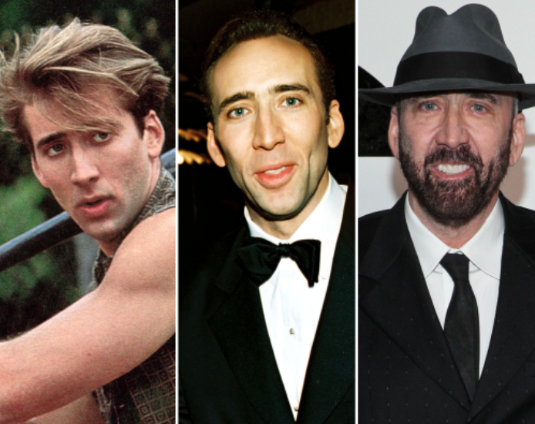
Introduction
Nic Cage has acted in 104 movies since 1982
Movies are multiple genres and have various ratings (average rating of all movies is 6.0)
Cage has had successful acting career along with roles of director and producer
Notes:
Academy Award winner Nicolas Cage has had a successful career in acting since his first movie role in 1982. Over the span of his career, the movie star has acted in 104 movies across multiple genres. Those movies have attained various ratings averaging 6.0. In addition to acting, he has also added the titles of director and producer to his credits

Slide 3

Business Problem
Predict randomly generated existing movie ratings will be higher than the average of all movie ratings
Average movie rating is a 6.0
Movie genre ‘Drama’ selected for movies to predict ratings from
Logistic Regression modeling used for prediction
Notes:
The business problem for this project is to predict randomly generated existing movie ratings to be higher than the average rating of all of his movie ratings, which was determined as 6.0. The movie genre ‘Drama’ was selected as the data to use for prediction. Logistic Regression modeling was used to predict the movie ratings.

Slide 4
Data Explanation
Secondary data collected from IMDb movie database
Cinemagoer package in Python used for data collection
Data contained 32 features / 109 rows
Mixed data: categorical & numerical
Notes:
Secondary data for this project was collected through the Imdb movie database using the Cinemagoer package in Python. Overall, the data contained 32 features and 109 rows. All data used for the project was categorical and numerical.

Slide 5
Features:
32 Total
Title [title]
Rating [rating]
Genres [genres]
Votes [votes]
Languages [languages]
Runtimes [runtimes]
Countries [countries]
Plot Outline [plot outline]
Director [director]
Year [year]
Writer [writer]
Producer [producer]
Composer [composer]
Cinematographer [cinematographer]
Editor [editor]
Editorial Department [editorial department]
Casting Director [casting director]
Art Direction [art direction]
Costume Designer [costume designer]
Make Up [make up]
Production Manager [production manager]
Assistant Director [assistant director]
Art Department [art department]
Sound Crew [sound crew]
Special Effects [special effects]
Visual Effects [visual effects]
Stunt Performer [stunt performer]
Production Companies [production companies]
Distributors [distributors]
Special Effects Companies [special effects companies]
Other Companies [other companies]
Original Air Date [original air date]
Notes:
Below lists the 32 features that are included in the dataset.

Slide 6
Methods
Identified genres and determined which one to use for prediction modeling
Notes:
While analyzing the data, it was discovered that most of Nic Cage’s movies were categorized by multiple genres in alphabetical order. A histogram was created of the individual genres. Those genres were then contained in a dictionary indicating the instances of movies per genre.

Slide 7
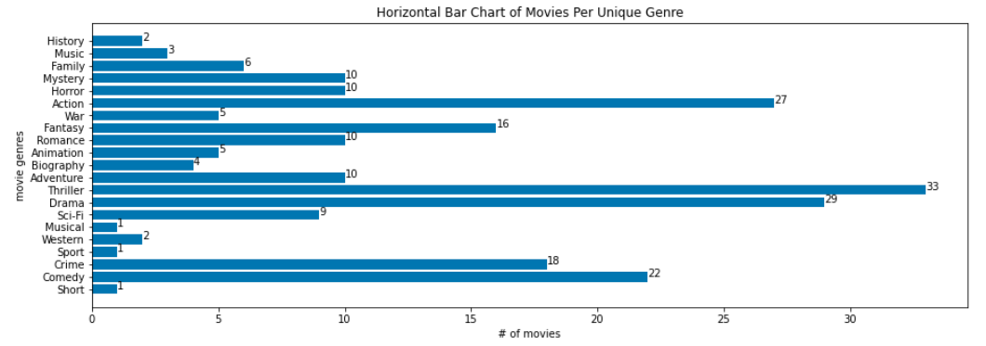
Unique Genres & Movies Per Each 21 Total Genres
Notes:
As you see here on this slide, the top five genres with the most instances of movies were ‘Thriller’ at 33, followed by ‘Drama’ at 29, ‘Action’ at 27, ‘Comedy’ at 22, and ‘Crime’ at 18. A function was then created to assign the genre with the most instances from the group of multiple genres by replacing it as that only instance. Once this was completed, the next step was to find the top genres with the most instances for prediction. By using assumption and approximation, the decision was made to extract genres with 10 or more instances per movies only. This is because it was ideal for training and testing with more data to work with. The top genres with 10 or more instances per movies included: ‘Comedy’, ‘Crime’, ‘Drama’, ‘Thriller’, ‘Adventure’, ‘Romance’, ‘Fantasy’, ‘Action’, ‘Horror’, and ‘Mystery’.

Slide 8
Methods
Dropped null values from dataset
Reclassified ratings
Created six fields for regression
Selected subset of four movies for validating prediction accuracy
Ranges created for numeric features
Notes:
Movies with premiere dates for 2022, 2023 and TBA were also missing other values that were necessary for prediction. Unfortunately, this data would not be sufficient to use for predicting ratings and as a result, it was removed from the main DataFrame. After removing, the dataset contained 33 features and 104 rows.
The next step of data cleaning entailed adding numeric fields for the columns [runtimes] and [year]. Then, the ratings needed to be reclassified. As the average across all movies was a 6.0 (this was concluded from the histogram), it was determined that this would be the threshold as to whether a movie was a success or a failure. A new column was created as [reclassified_rtg]. If the rating was equal to or greater than a 6.0, the function would return a 1. If the rating was below a 6.0, it would return a 0. The genre was then reclassified. As mentioned earlier, the multiple genres were listed in alphabetical order (versus an order of most genres listed first, next, last, etc.) in most of Cage’s movies. The genre ‘Thriller’ had the most instances with 55, followed by ‘Drama’ with 28, then ‘Comedy’ with 11, ‘Action’ with 8, ‘Fantasy’ with 1 & ‘Horror’ with 1.
A list of six fields were then created for regression: [title], [reassigned_genre], [votes], [runtimes_n], [year_n], and [reclassified_rating]. The ‘Drama’ genre was determined as the genre to be used for prediction. This decision was based on the genre containing the second highest number of instances and using ‘Thriller’ might appear to be biased. Using any genre lower than ‘Thriller’ or ‘Drama’ would not work for modeling with a smaller number of instances. Since there was no longer any data for prediction (it had to be removed as it had too many missing values in the predicted fields), a subset of four movies was selected from the ‘Drama’ genre and removed from the main dataset.
Ranges were then created for numeric features [votes], [runtimes], and [year] as these would be used as predictors. Percentiles from the histogram were used (minimum, 25, and 75). This was to ensure an objective method was used to reassign the numeric values to categorical variables (0, 1, 2). For the DataFrame of the four predicted movies, features [votes], [runtimes], and [years] were reclassified.

Slide 9





4 Movies for Subset
Movie selection was subjective decision
Movie titles:
Deadfall
The Runner
It Could Happen to You
City of Angels
Notes:
The selection of these four movies was a subjective decision. The movies that were chosen from the ‘Drama’ genre included: Deadfall, The Runner, It Could Happen to You, and City of Angels.

Slide 10

Analysis
Logistic Regression used for analysis
Test and train split set created for genre ‘Drama’
Test size 35% / Train size 65%
Nine movies randomly selected for prediction
True values were already known for prediction
Notes:
Logistic Regression modeling was used for analysis. A train and test split set were created (for the genre ‘Drama’) to help prevent overfitting. Nine movies from the test set were randomly generated for prediction each time the model ran. For fields that were dropped, the [reclassified_rating] feature was added. The test data set size was 35%, and the training data was 65%. True values were already known in the test dataset for the rating. The model would then try and predict those.
Using np.ravel (this is to avoid an sklearn error), the next step was to fit the model. From there, the model was used to predict the test data from the train data.

Slide 11
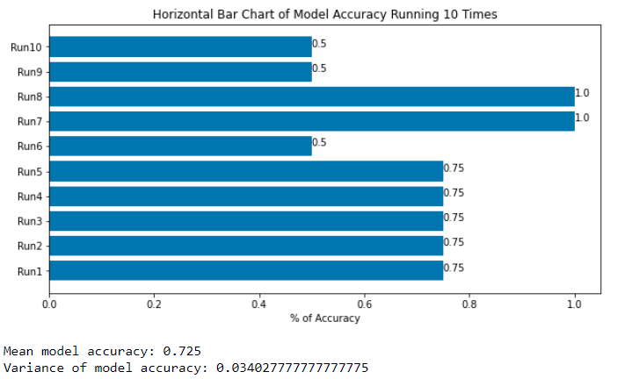

Model Accuracy Mean of model accuracy: 72.5% Variance of model accuracy: 3.40%
Model was run 10 times
Notes:
A confusion matrix was created for ratings in the test dataset from the predicted dataset. The accuracy of prediction showed whether the test dataset had a rating greater than the average of 6.0. The model ran 10 times, and as seen in this visualization, the mean model accuracy was 72.5%, and the variance of model accuracy was 3.40%.

Slide 12
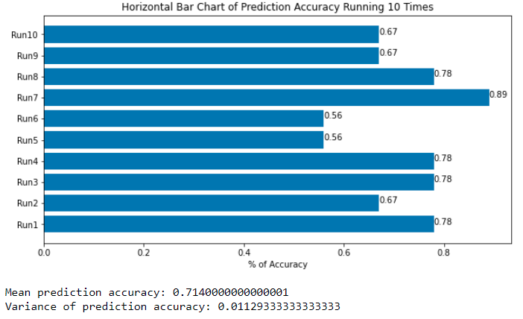

Prediction Accuracy Mean of prediction accuracy: 71.4% Variance of model accuracy: 1.13%
Model was run 10 times
Notes:
When the model was executed on the dataset to predict the test data, the backup copy of the original dataset was used to see the movie title. This was because [title] feature was dropped when the model was created. Another confusion matrix was created to determine the prediction accuracy. As seen this visualization, this model also ran 10 times, with a mean prediction accuracy of 71.40% and a variance of prediction accuracy of 1.13%.

Slide 13

Conclusion
Both models showed favorable results
Conclusion cannot be made running model only one time
Genre ‘Drama’ showed confidence that predicted rating is higher than average rating of movies (6.0)
Notes:
The means for both model and prediction accuracies showed favorable results and conclusions can be drawn. While predicting nine out of 15 movies may seem like a stretch on a project like this, predictions in life may be made on something much less. It is important to note however, that a conclusion cannot be made running the model only one time. Using the subset of movies from the genre ‘Drama’ showed confidence that a predicted rating is higher than the average rating, which was 6.0 (when ran 10 times).

Slide 14

Future Uses/Implementation Plan
Run model with different actor and find additional features
- example using feature [votes]
Use any movie regardless or genre instead of reclassifying
Add more genres for prediction
Run model 100 times to see more results to see statistical outcomes
Notes:
a future use might be to try the model with a different actor and find additional features for prediction. Another idea with the existing dataset would be using the feature [votes] instead of [rating] to predict. Or, instead of reclassifying and assigning the genre with the most instances, use any movie regardless of genre.
It is recommended to iterate the existing model at least 100 times to see what other results occur. I would also recommend using additional genres and running the model with those. Another type of modeling might be beneficial if trying to predict other features, such as sentiment analysis. Or possibly, using a time series study to see how many movies Nic Cage films a year and look at that as a new business problem.

Slide 15

Ethics
Project was conducted for informative and entertainment purposes only – not intended to harm Nic Cage’s career
No ethical implications based on results
Assumptions were made due to mixed data (categorical and numerical)
Decision-making was made as objectively as possible
Notes:
This project was conducted for informative and entertainment purposes only, by sharing results of the predicted rating accuracy. Since this is not damaging to Nic Cage’s career, I do not feel there are any ethical implications working on this project based on those results. As the data contained categorical and numerical values, assumptions were applied due to the mixture of values. I tried to be as objective as possible when making those assumptions, however. As I continue to work more with data, I understand that those decisions can have an impact on the focus of the study, as well as those who participated in it.

Slide 16
References
IMDb.com. (n.d.). Nicolas Cage. IMDb
Retrieved from https://www.imdb.com/name/nm0000115/bio?ref_=nm_ov_bio_sm
Wikimedia Foundation. (2022, March 27). List of awards and nominations received by Nicolas Cage. Wikipedia. Retrieved from https://en.wikipedia.org/wiki/List_of_awards_and_nominations_received_by_Nicolas_Cage
Wikimedia Foundation. (2022, May 26). Nicolas Cage. Wikipedia.
Retrieved from https://en.wikipedia.org/wiki/Nicolas_Cage
Cinemagoer. PyPI. (n.d.). Retrieved from https://pypi.org/project/cinemagoer/. - Used to retrieve data from IMDb database for Nicolas Cage person ID: 0000115

